Slide 1
COMPSYS 302- PHASE II
Wan Chung (Benjamin) Tong
Electrical and Electronics Engineering Part III

Slide 2
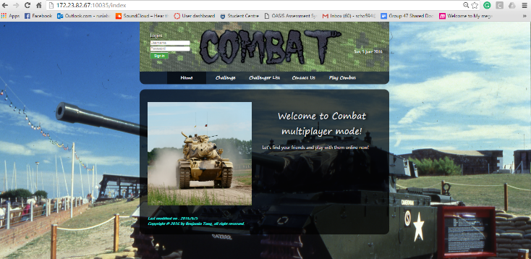
Brief and Requirements
Recap on Phase I – Combat on Java
Java Application
Features
Attractive application
Phase II
Cherrypy/Python Server
Communication between Cherrypy/Java
Attractive website

Slide 3
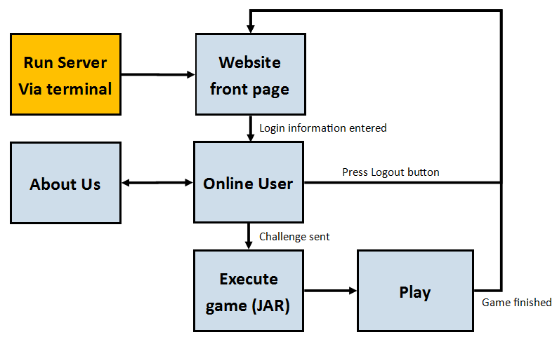
Top Level View of the System

Slide 4
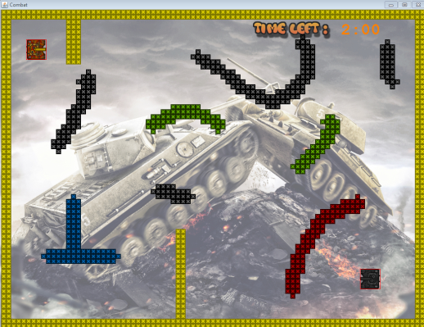
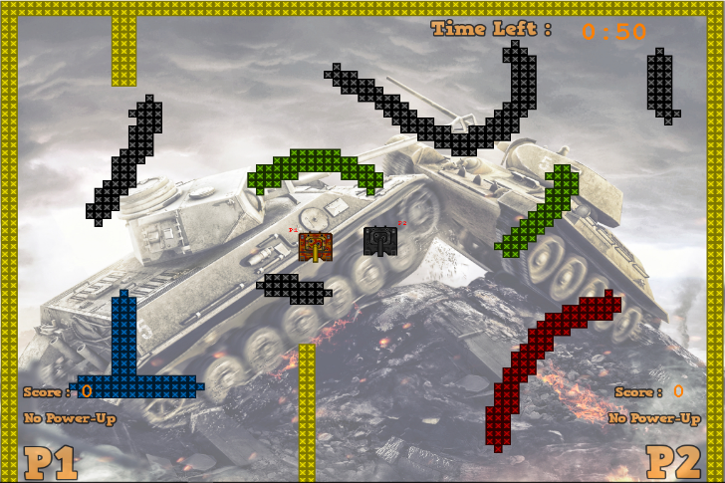
Screenshots (Evidence)

Slide 5
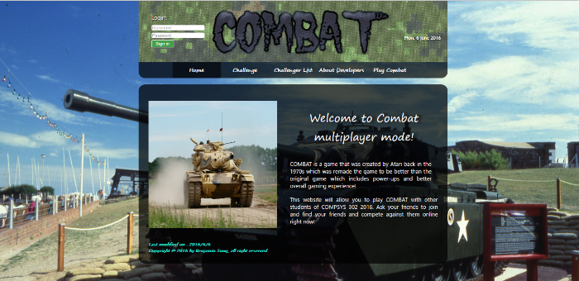
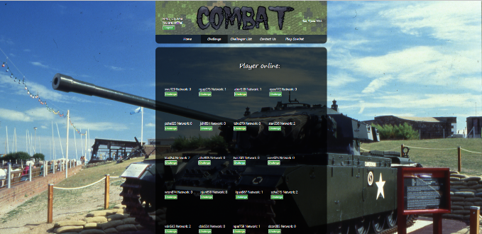
Screenshots (Evidence)

Slide 6
Special Features – Unique Design
Best feature: Web Design
Use of Background pictures and images
Navigation bar
Popup notifications
Clear buttons and information
Use of Databases
Faster and efficient use of information

Slide 7
Should the client pay me?
Reasons to pay
Design/Stylish Web Server
Modular/Pythonic code
Meets half the requirements

Slide 8
Future Improvements
Perfectly working Multiplayer system
All requirements up to standard
Entirely P2P system – No reliance on central server
Game information on Website during Gameplay

